Slide 1
Virtual Fall Investor Summit November 16, 2020
Sanjay Singh, Executive Chairman and Gary Medved, CEO/President

Slide 2
Introduction to Mace Security International, Inc. (OTCQX – MACE)
Mace Security International, Inc., located in Cleveland, Ohio, is a manufacturer and provider of personal safety and security products to consumer and law enforcement markets worldwide.
Mace® Brand is the original manufacturer and market leader in the defense spray segment and has over 40 years experience developing aerosol defense spray dispensing technologies for both the consumer and tactical markets around the world. The Company also markets products through the well respected Vigilant (R), Tornado (R), and Takedown (R) Brands.
Mace® directly distributes and supports its branded products through strategically targeted customer channels that include selected retailers, wholesale distributors, independent dealers, e-commerce channels, and our website, Mace.com.

Slide 3
Our Mission

Slide 4
Provide
Family & Community Safety through
Individual Empowerment

Slide 5
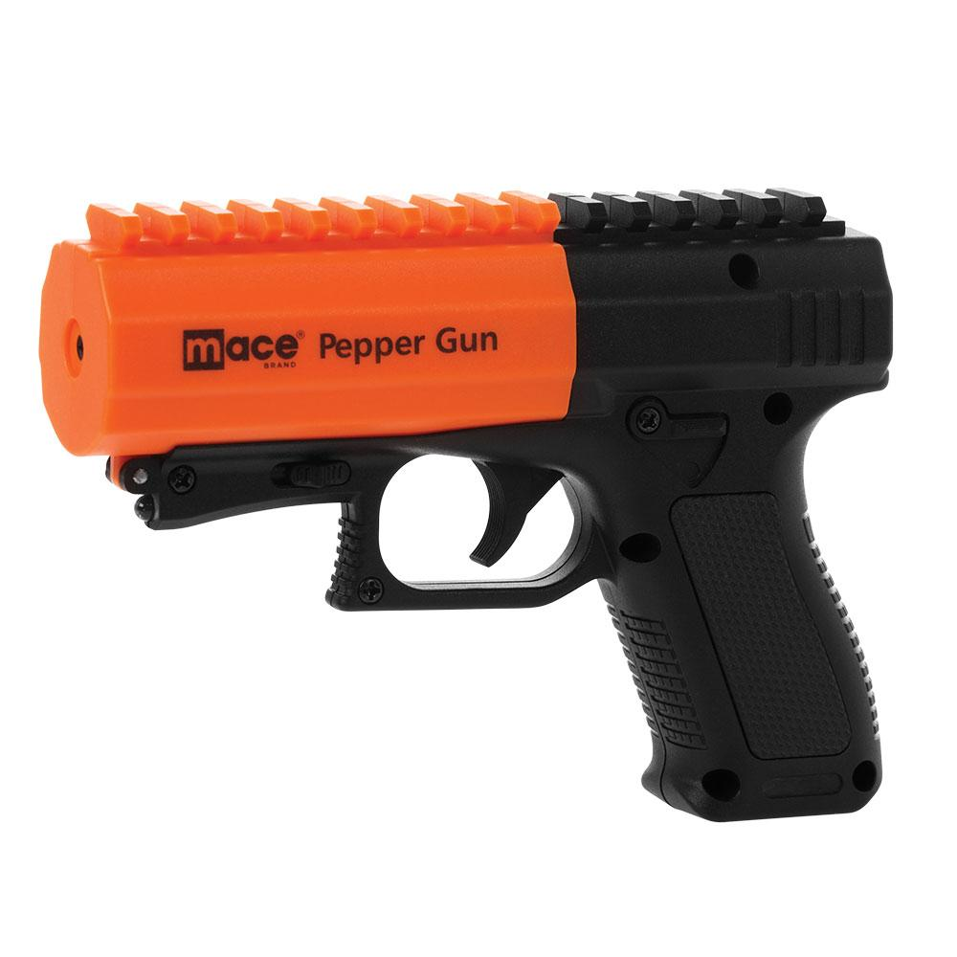
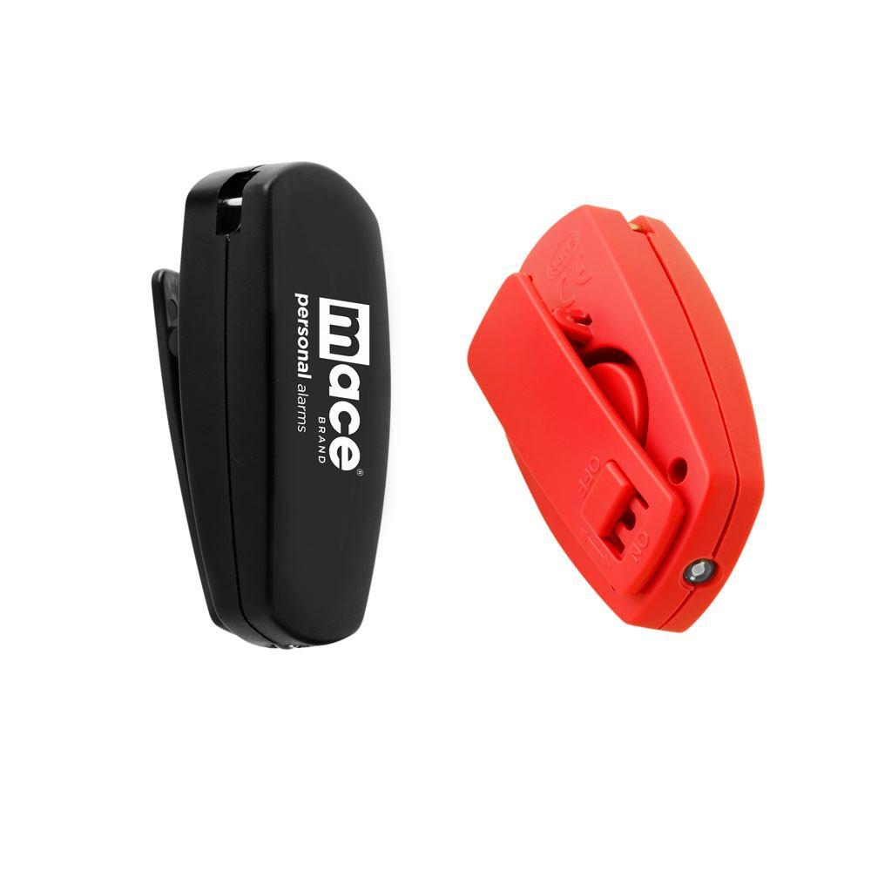
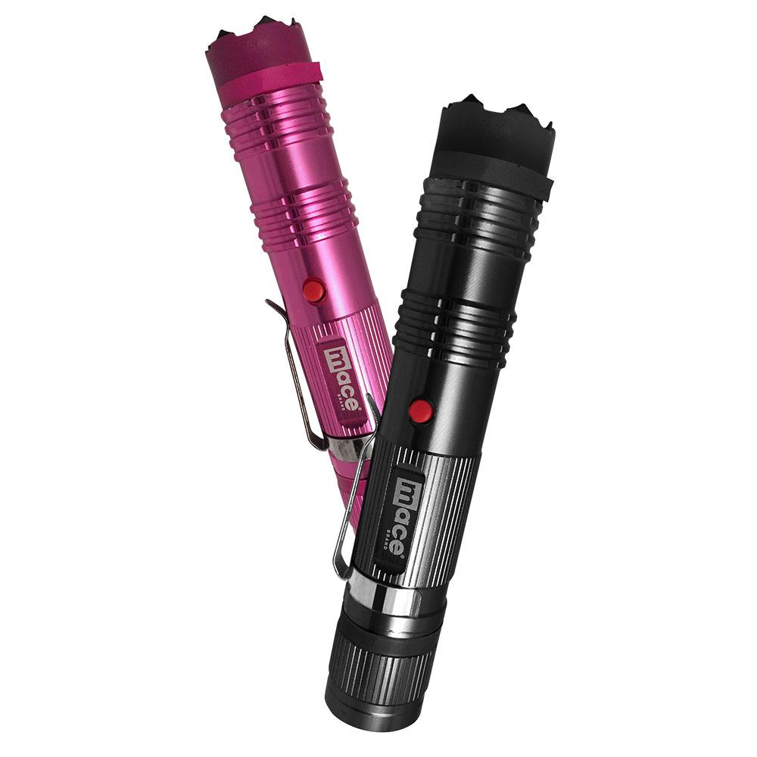
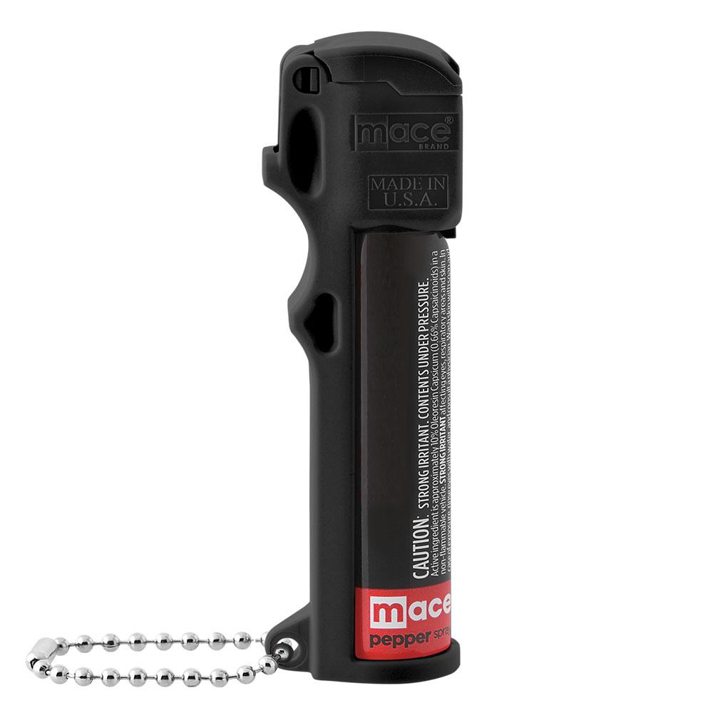
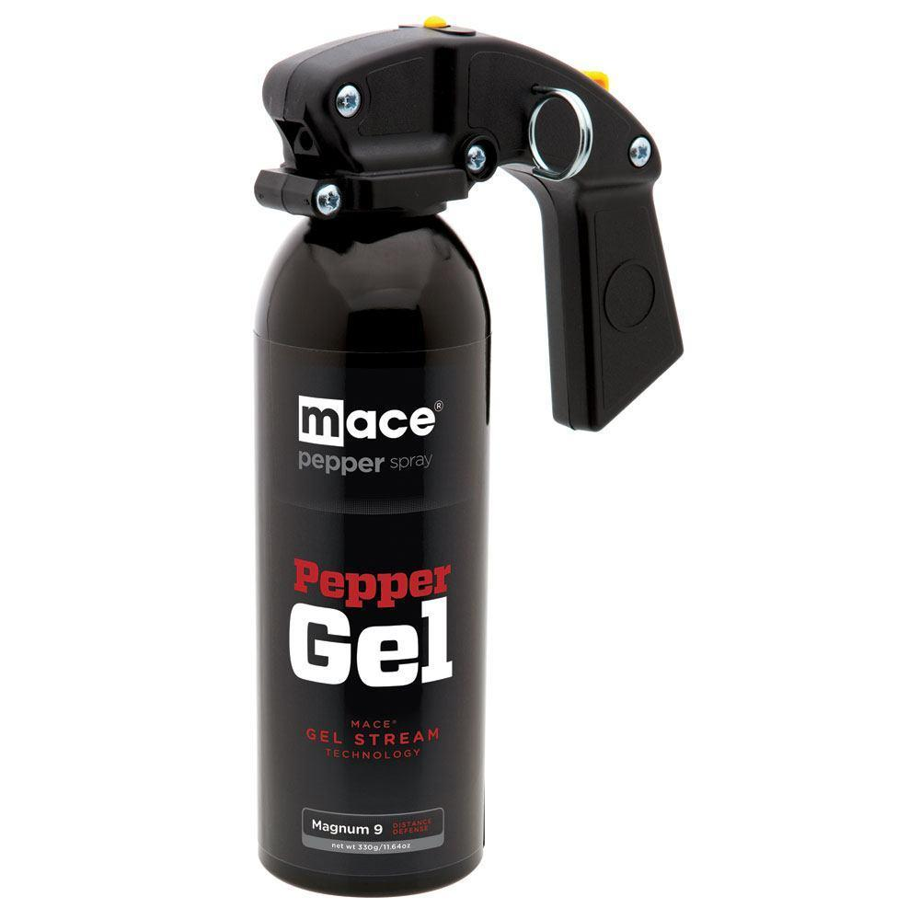
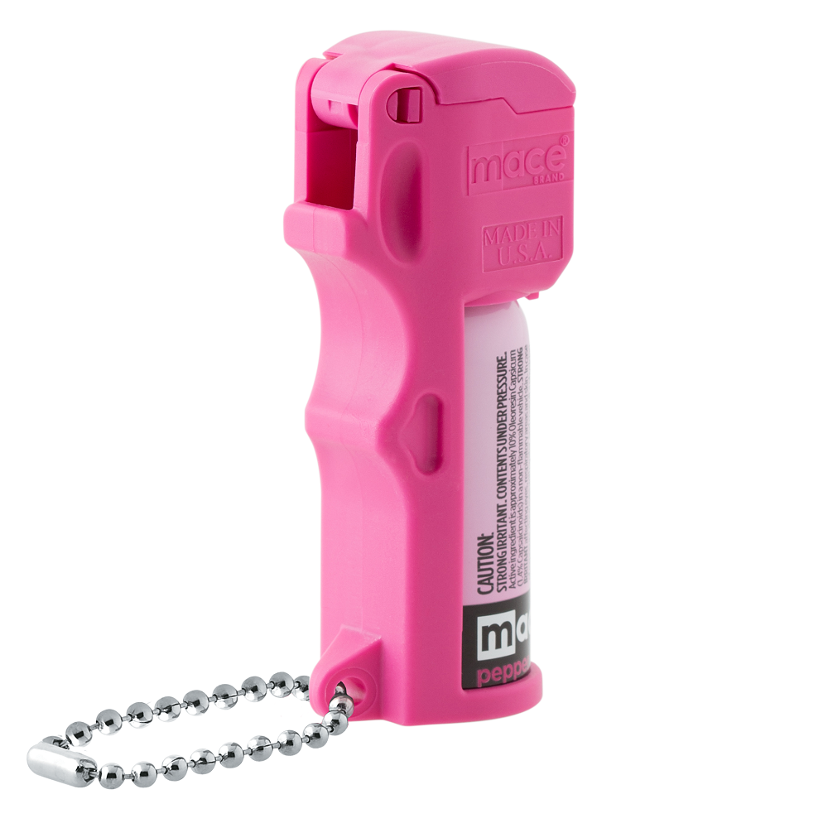
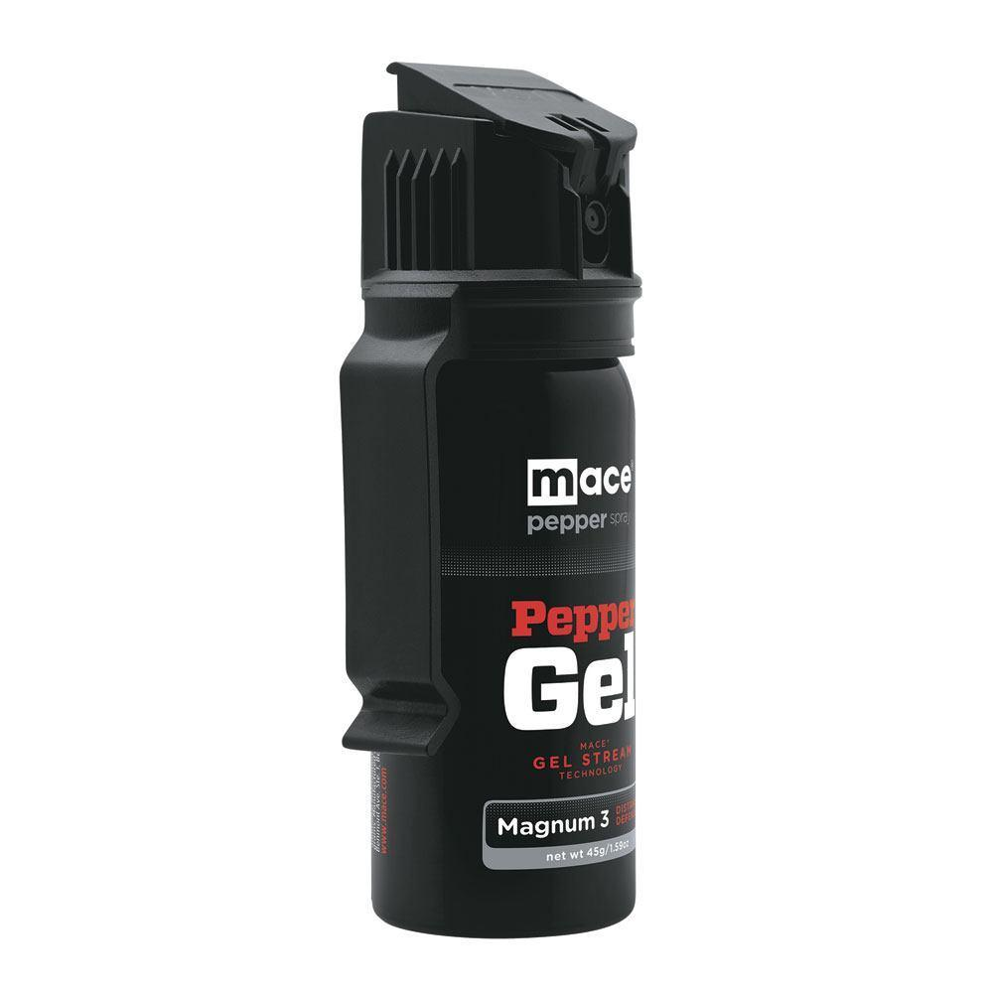
Current Product Lineup
Personal Alarms
Pepper Guns
Stun Guns
Pepper Spray
Pepper Gel

Slide 6
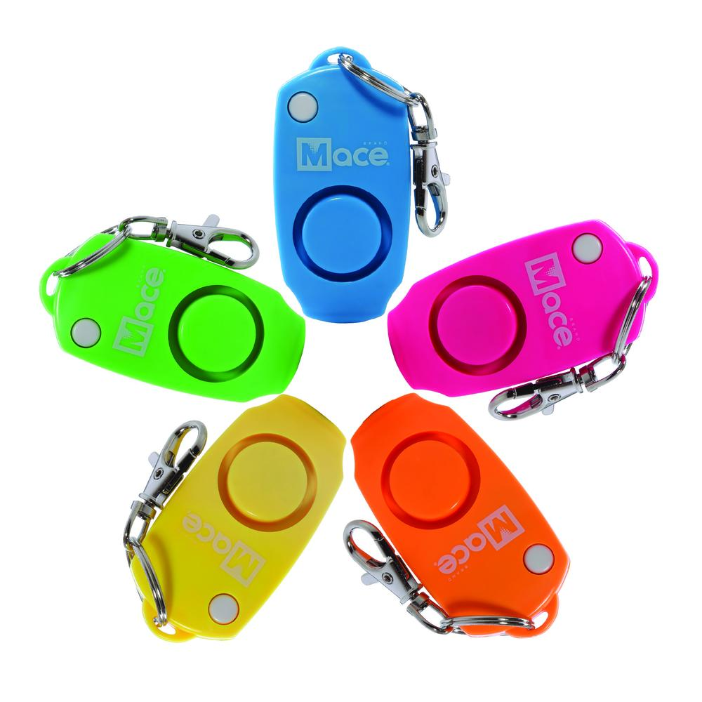
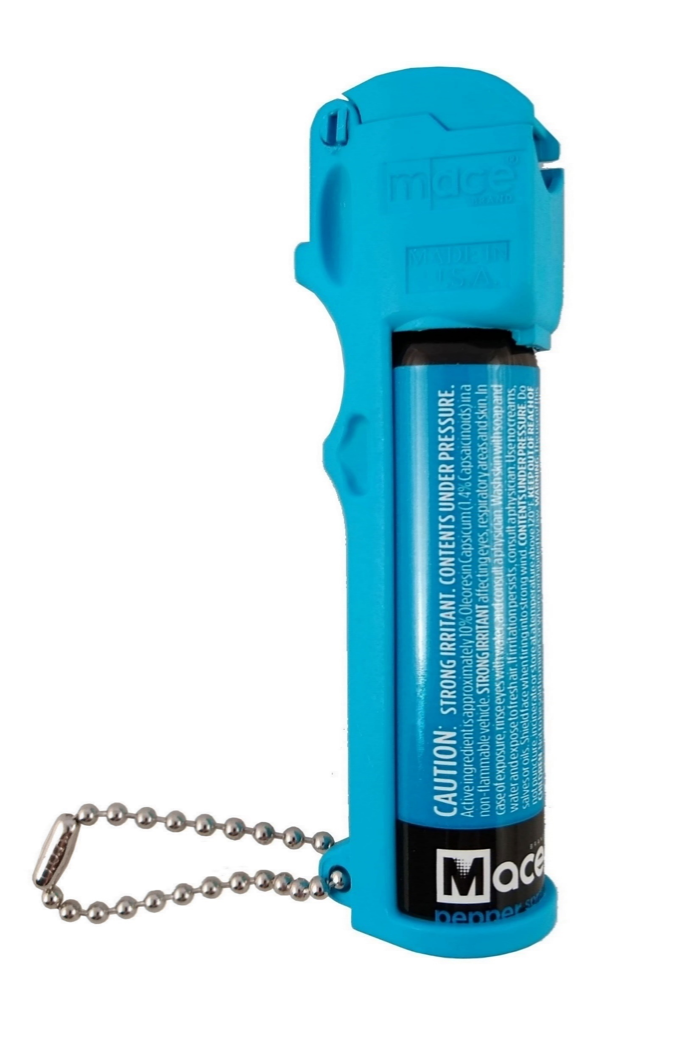
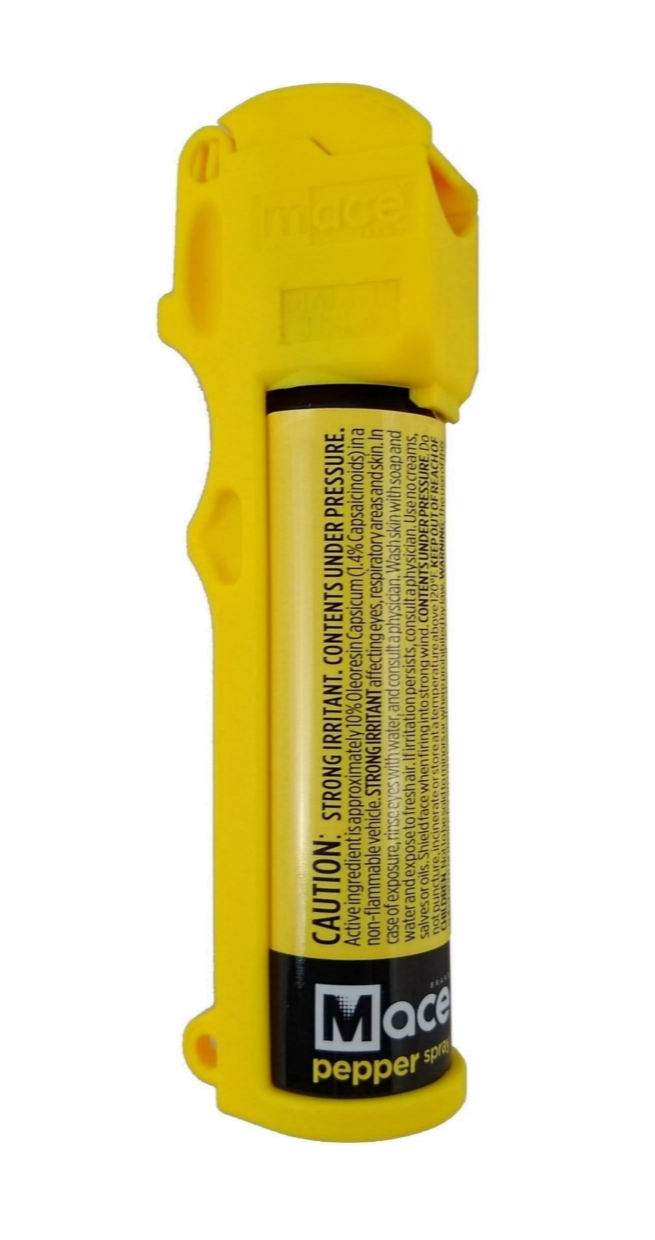
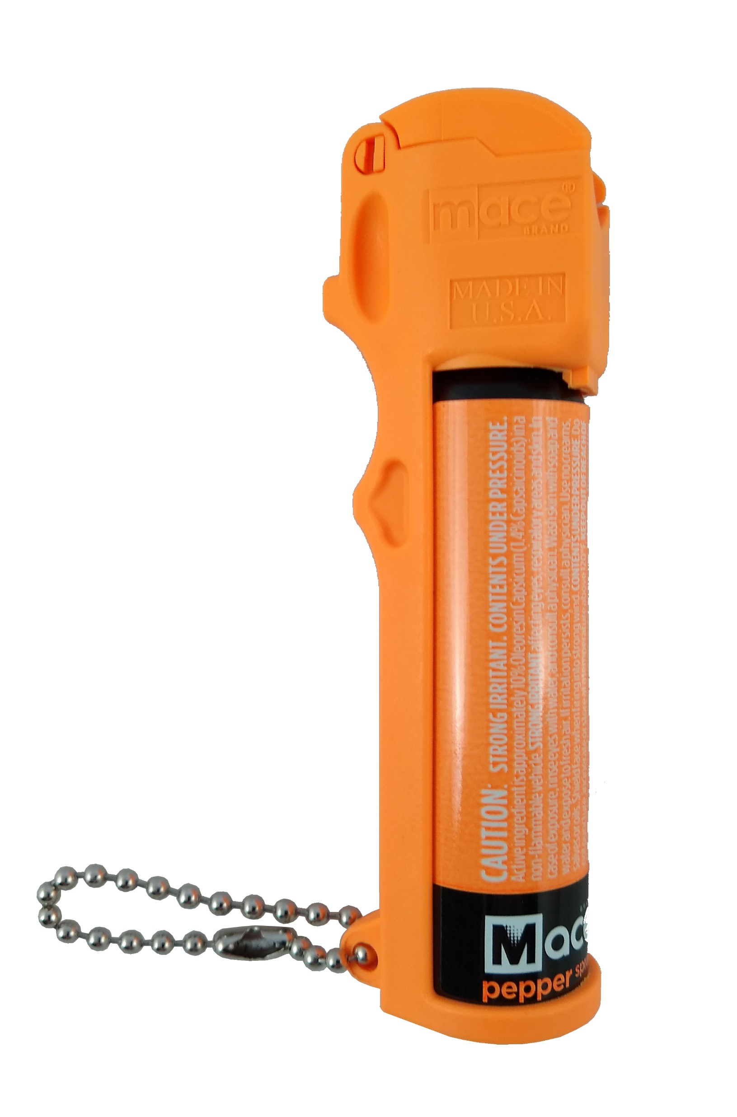
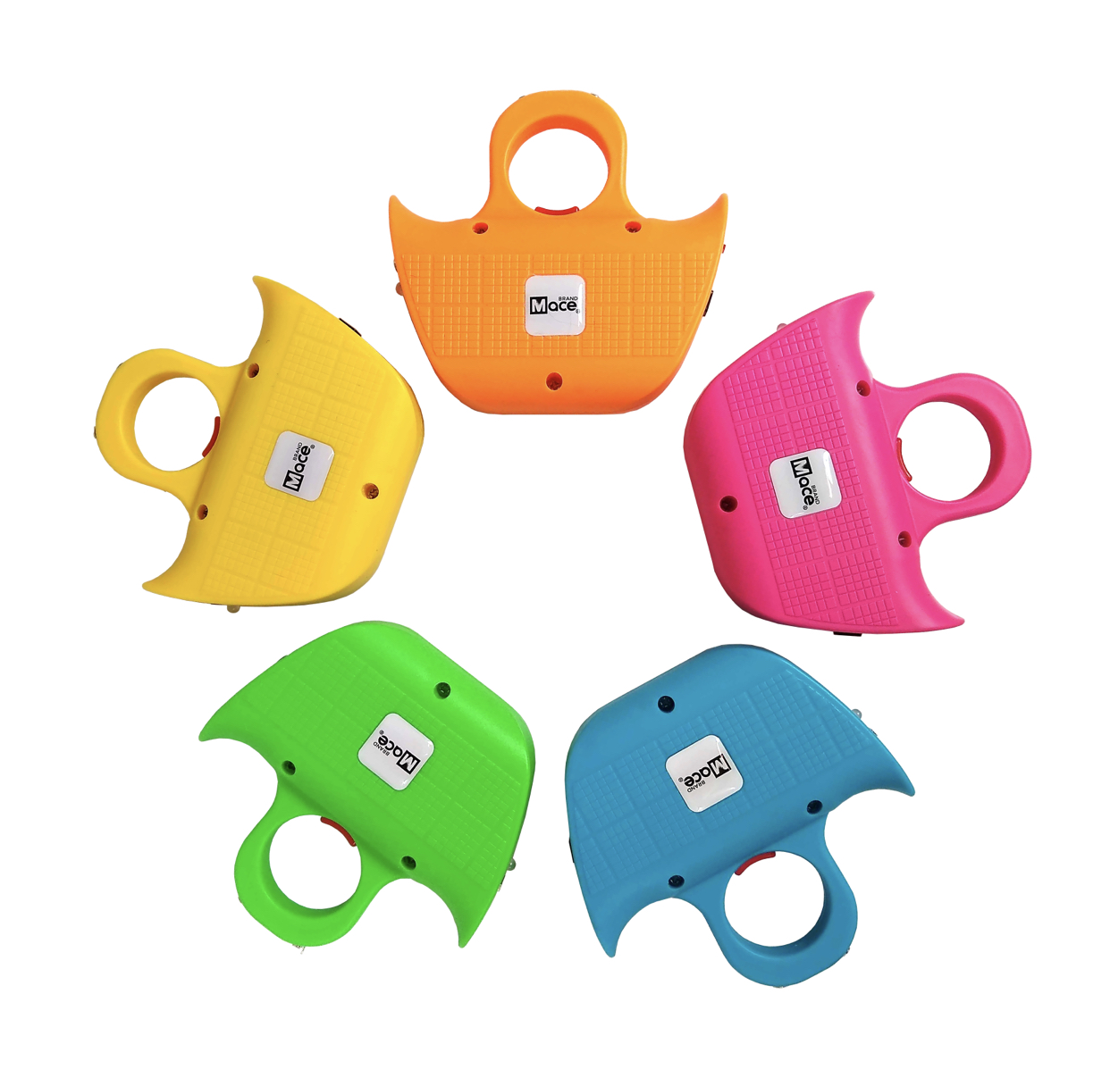
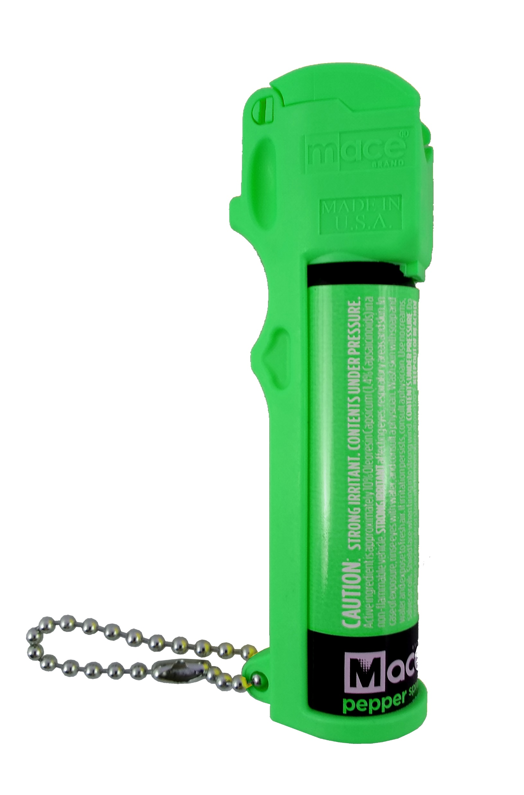
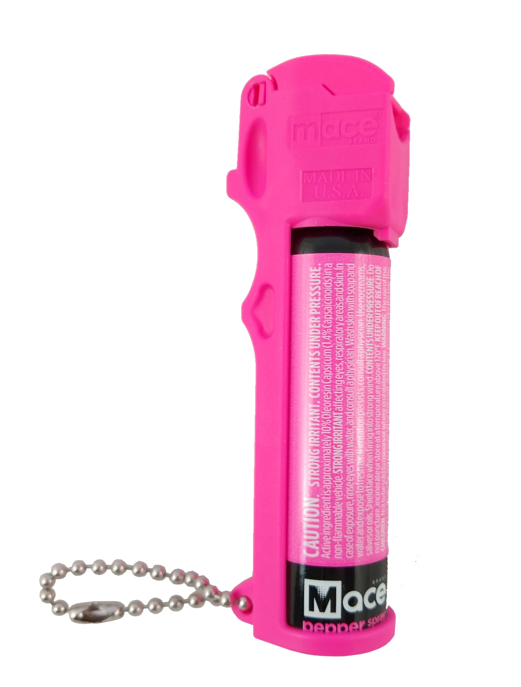
Product Line Refresh

Slide 7
We are THE BRAND

Slide 8
Brand Awareness (Among Male Buyers, Armed Women, and Unarmed Women)
Source: Nottingham-Spirk Consumer Insight Survey March 2020

Slide 9
Brand Comparison
 | Strong Brand Recognition | Original & Authentic | Product Innovator | Quality Level | Retail Price Point | Retail Margin | DTC Sales Leader | Amazon Sales Leader
Mace Brand |  |  |  | High | Premium | High
Sabre |  |  |  | Medium | Opening Price Point | Medium
Others |  |  |  | Med-Low | Med-Low | Med-Low | O.K. | O.K.

Slide 10
Brand Awareness (Searches per Month for “Mace”)
Source: Semrush March 2020

Slide 11
Current Sales Distribution

Slide 12
YTD Incoming Orders & Drivers

Slide 13
YTD 09/30/20 Incoming Orders – 12 Day Moving Average
+100%
0
Jan. 1
Sept. 30

Slide 14
Socio-economic drivers of revenue
Social climate
Credibility of police force
Divisive political environment
Consumer sentiment
Crime rates
Weather
Outdoor activities
College attendance
Health fads
Rate of GDP change
Price of resin

Slide 15
3Q20 Key Financial Highlights

Slide 16
Key Financial Highlights 3Q20
Net Sales of $4.76MM, up 94% or $2.31MM versus prior year driven by organic growth, product line extension to current customers, and sales to new customers
Gross Profit was $1.95MM up 108% versus prior year
Net Income was $682K an increase of $843K versus prior year

Slide 17
Select Financial Stats through 3Q20 –
positive and sequential improvement
MM | Income Statement
 | FY 17 | FY 18 | FY 19 |  | 1Q 20 | 2Q 20 | 3Q 20
Sales | $ 10.0 | 11.5 | 10.5 |  | 2.8 | 3.5 | 4.8
Chg. YOY |  | 15.1% | -8.6% |  | 3.0% | 16.0% | 94.0%
Gross Margins | 42.8% | 36.7% | 36.2% |  | 38.7% | 40.8% | 41.1%
SG&A | $ 4.1 | 4.8 | 5.1 |  | 0.9 | 0.8 | 1.2
EBITDA | $ 0.27 | ($1.5) | ($1.2) |  | $0.2 | $0.6 | $0.8
Rate | 2.7% | -13.3% | -11.5% |  | 8.6% | 17.2% | 17.3%
MM | Treasury
 | FY 17 | FY 18 | FY 19 |  |  | 2Q 20 | 3Q 20
CASH | $ 0.7 | 0.2 | 0.3 |  |  | 1.6 | 0.5
DEBT | $ 1.1 | 1.0 | 1.1 |  |  | 1.6 | 1.0
DSO | 62 | 59 | 75 |  |  | 76 | 70
DSI | 127 | 109 | 98 |  |  | 132 | 107
Ent. Value | $ 24.34 | 18.4 | 16.6 |  |  | 17.3 | 29.3
OCF/ASSETS | -3% | -5% | 1% |  |  | 12% | 2%

Slide 18
Q3 ‘20 OVERVIEW
Revenue/EBITDA Q3 Comparison
94%
Net sales grew by $2,310K driven by organic growth, strong e-commerce sales, addition of new customers and product line extensions.
EBITDA increased by $860K vs last quarter
Volume impact to gross margin was $877K
Efficiencies and higher fixed cost leverage were $138K
SG&A was higher by $177K due to higher variable sales commissions and performance-related incentives
Targeting a minimum EBITDA rate of 15%

Slide 19
3Q20 Summary
Digital sales continue growing at triple-digit rate (on a percentage basis)
Incoming order trends remain strong
2 new products placed in key retailers
New products introduced at retail continue to strongly outpace 2020 forecasts
Robust backlog heading into 4Q20

Slide 20
Going Forward

Slide 21
Growth with Financial Improvement
Retail
NEW Retailers
Flying J
Bass Pro
Matco
NEW Dealers
NEW Hooks
Walmart
AutoZone
Consumer-Centric!
Digital
Website
Design
Social Media
Campaigns
Analytics
Amazon
Search
New Products
Consumer Insights
Targeting two new products for 2021
Financial
Focus on Manufacturing Efficiency Improvement
EBITDA target 15% minimum

Slide 22
Attractive Financial Characteristics

Slide 23
Investment Thesis
Market leader in Brand Awareness
Favorable Climate for Non-Lethal Personal Safety and Security Product
Conservative balance sheet, low capital intensity, access to capital markets
Lowered break-even point allowing future revenue increases to fall to bottom line
Transparency in governance and public reporting

Slide 24
Conservative Capital Structure
As of September 30, 2020
Short-Term Debt (less than 1 year)
$223 Term Debt
$379 PPP Loan
Long-Term Debt (over 1 year)
$116 Term Debt
$243 PPP Loan
Total short term and LT debt = $961
Cash on hand $549
Interest rates are fixed at 2-5% and are pre-payable without penalty

Slide 25
Additional Investment Insights
NOL Analysis: Company has approximately $56M in tax NOL Carryovers, or $0.88 per share of (gross) NOL
Less than $8M expiring by the end of 2022
Additional opportunities to monetize NOL’s include licenses or royalties, strategic partnerships, or tax shield for acquisitions
Mace follows transparent public reporting, and strong governance through a diverse, independent and annually-elected BOD
.

Slide 26
Notables
Iconic brand : Most people know of Mace pepper spray
Market : Substantial wallet size– owing to a rise in the global need to self-protect using non-lethal ways
Branding : Promoting our products and its various uses
Differentiator : Innovation, new products, technologies and licensing the MACE name, strong management team
Financials : Recent improvements in four wall operating efficiencies leading to strong EBITDA margins

Slide 27
Driving Shareholder
Returns
Positioned for Growth
Key Priorities
Long-Term
Mid-Term
Employee Safety and Culture
Acquisitions
New products/extensions
Continued channel addition and retailer penetration
Automation
International
Expand personal safety device offerings
Short-Term
Employee safety and culture
Reduce process steps by 30%
Drive (minimum) 200 bp increase in Gross Profit Margins
Land (minimum) 4 new retailers
Increase DTC by (minimum) 3X
Investment in DTC and AI
New products/product line extensions
Licensing deals
Employee safety and health
Redefine mission/culture code
Order to Cash Management
New-look product and packaging
Management of supply chain
Lean out non value-added processes
Advertising/awareness/IR investment

Slide 28
Thank You!

