Slide 1

2Q22 Highlights
August 2, 2022

Slide 2
About Us
Mission Statement
Provide
Family & Community Safety through
Individual Empowerment
Vision Statement
To be the most customer-centric company that provides innovative products to keep our customers safe all the time and is an expert in the non-lethal product segment

Slide 3
Supplemental Sections
Section 1 Finance
Section 2 Sales & Marketing
Section 3 New Products
Section 4 Focus in 2022

Slide 4
Section 1 Finance
Economic Conditions and Revenue
Key Financial Highlights 2Q22
2Q22 Overview
Cash Flow 2Q22 vs 2Q21
Select Financial Stats through 2Q22

Slide 5
Economic Conditions
Revenue growth continued to slow in 2Q22 vs. 2Q21 as POS traffic slowed
Inflation of basic necessities changed buying patterns of consumers
Supply chain disruptions and slow down in sales led to inventory levels remaining high
Raw material, component and freight price increases continuing
Improved direct labor efficiency 32% from 2Q21
Reduced four-wall manufacturing costs 38% from 2Q21
Our break-even point is now $10MM in annual revenues, a reduction of $2MM
Every incremental sales dollar generates an approximate incremental 34% EBITDA

Slide 6
Top Line and the Mace® Brand
  Future revenue from NEW business
    Advanced Auto - 1SKU x 4,000 locations; 2nd SKU under review
    CarQuest – 1 SKU x 1,000 locations (min);
    AutoZone - 2 additional SKUs x 3,300 locations
    Lowes.com - 40+ SKUs
    Target.com - 1 SKU; added 12 new kits
    Cornwell Quality Tools – 750 mobile tool franchisees in the U.S.; rolled out in May 2022
    National Retailer with 6,000 locations – to be announced in Q2; revenues in Q3 onwards
  Multiple new retailers currently under discussion; addition of Omnichannel Sales Manager - $14MM of actionable opportunities identified
  Increasing existing dealer & distributor business with uniquely better new products; added two new products in Q2 and adding 2 new co-branded products in 2H22

Slide 7
Key Financial Highlights 2Q22
Net Sales of $1.981K down 42%, versus 2Q21
  170% increase in International sales
  Mace.com orders were up 27% vs PY
  Slowdown in consumer impulse purchases due to inflation concerns led to significantly lower retail sales
Gross Profit was $787K, down 41%, versus 2Q21
Gross Profit rate increased to 40%, versus 39% in 2Q21
Adjusted SG&A expenses decreased by $176K, versus 2Q21 adjusted SG&A
Working Capital decreased by $830K, compared with 4Q21
  Increase in debt of $865K
Adjusted EBITDA for 2Q22 a loss of ($116K), versus income of $234K in 2Q21
  Strategic alternative review related legal costs $110K
  Transition payroll/temporary labor cost $45K
  Non-cash stock compensation $50K

Slide 8
2Q22 OVERVIEW
(42%)
Net sales decreased by $1,415,000 as a result of a slowdown in retail impulse purchases due to inflation concerns. International sales increased 170% and sales to non-traditional customers in healthcare and hospitality industry increased 80% in 2Q22. Q2 21 sales benefited from carryover orders from social unrest or 2020.
Adjusted EBITDA declined by $350,000 vs 2021
Gross profit was down $539,000 due to lower sales volume. However, Gross profit rate improved to 40% in 2Q22, compared to 39% for same period in 2021.
SG&A when adjusted for (a) $110,000 in increased legal support primarily related to the Company’s announcement in the second quarter 2022 to explore and evaluate potential strategic alternatives for the Company, (b) $45,000 related to transition payroll/temporary labor costs associated with the Company optimizing its headcount and (c) non-cash stock compensation expense of $50,000 was $973,000 in the second quarter of 2022, compared to SG&A when adjusted for $52,000 of non-cash stock compensation expense was $1,149 in the same period in 2021.

Slide 9
Cash Flow Second Quarter 2022 vs 2021

Slide 10
Select Financial Stats through 2Q22

Slide 11
Section 2 Sales & Marketing
The Opportunity
2022 Q1 Sales Distribution
2022 Q2 Sales Distribution

Slide 12
The Opportunity
Home Sphere
128M households in America
Work Sphere
(Fear Gap)
5.6M employer firms in USA
99.7% are less than 500 employees
Professional Sphere
Social Sphere
209M+ citizens over the age of 18
Targeting an additional 550,000 end consumer purchases in the next 24 months or $11MM from retail and D2C.

Slide 13
2Q21 Net Sales
Private Label 9%
Int’l/Tactical/Other 16%
Retail 41%
E-Comm 33%

Slide 14
2Q22 Net Sales
Retail 29%
E-Comm 38%
Private Label 7%

Slide 15
Section 3 New Product Update
New Product Launched in 2022
New Product Pending Q2 launch

Slide 16
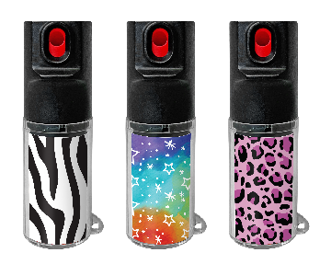
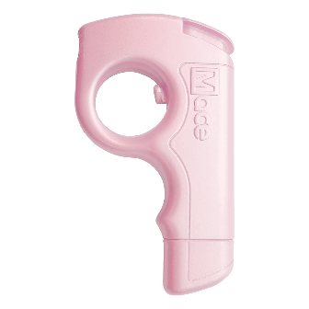
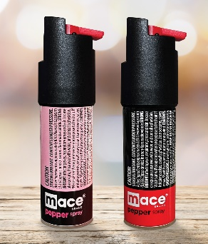
Section 3 : New Products and Extensions introduced in 2022
The Chameleon
10 ft range
Replaceable canister
Change the look by changing the insert
Made in USA
$9.99 @Mace.com
The Pocket Hero
10 ft range
Replaceable canister
Double safety to prevent mis-fires
Unique design for accuracy
Made in USA
$14.99 @ mace.com
The Twist Lock (2) Pack
10 ft range
Made in USA
$14.99 @ mace.com

Slide 17
Section 4 e-Commerce
The Amazon story from 2019-2021

Slide 18
Growth on AMAZON from 2019-2021
POS Data from Amazon for Sales of Mace Products
Significant increase in sessions resulting in a >300% increase in POS since 2019 and a best-in-class, double-digit conversion rate

Slide 19
Our Focus and Objectives in 2H 2022
Operate to a positive adjusted EBITDA
Deep focus on retail; actions on $14MM of identified opportunities
Further penetrate international and domestic base business
Introduce a new line of business in Q3
Introduce new co-branded products in 2H22
Reduce gross-to-net sales deductions and disputes

